Slide 1

I2C Client Linux Device Driver
Phan Như Khôi 20119189

Slide 2
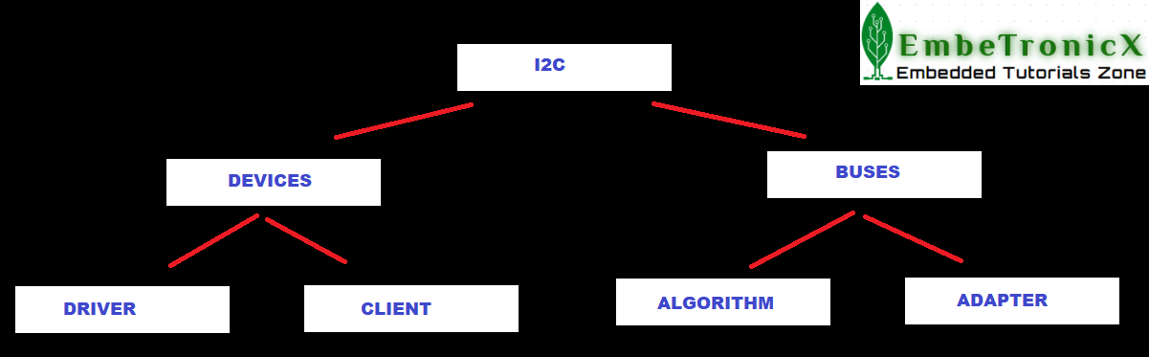
* Inter-Integrated Circuit Bus
* A method of exchanging serial data between two or more devices.
* Consists of one bus “Master” and one or more bus “Slaves”
The bus uses four connections:
1.SDA – the serial data line
2.SCL – The clock line
3.VCC
4.GND
I2C operation
Hardware Required
Raspberry Pi (Install Raspberry Pi OS (32-bit) with desktop in the SD card.)
2. SSD1306 OLED I2C Display

Slide 3
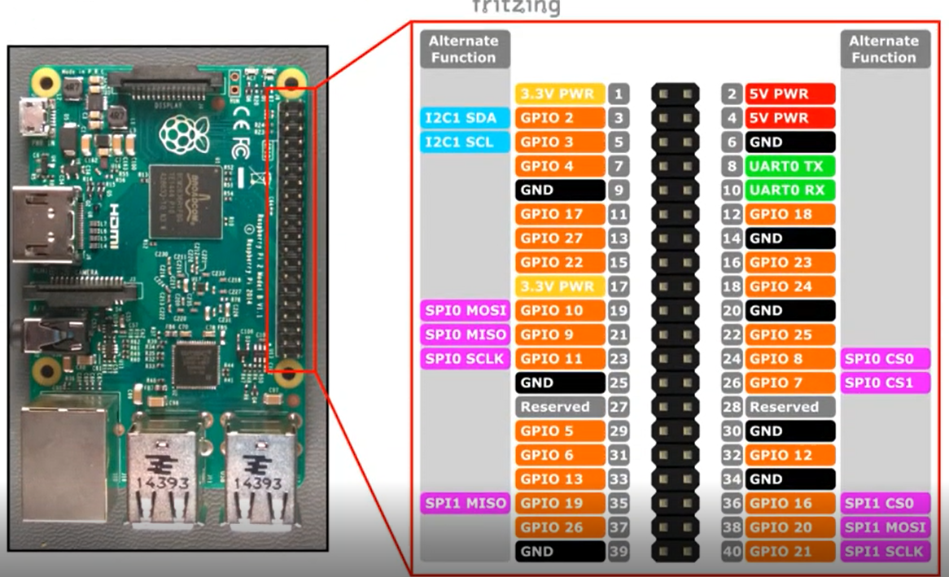

Slide 4
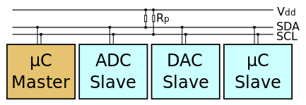

Slide 5
Get the I2C adapter.
Create the oled_i2c_board_info structure and create a device using that.
Create the i2c_device_id for your slave device and register that.
Create the i2c_driver structure and add that to the I2C subsystem.
Now the driver is ready. So you can transfer the data between master and slave.
Once you are done, then remove the device

Slide 6
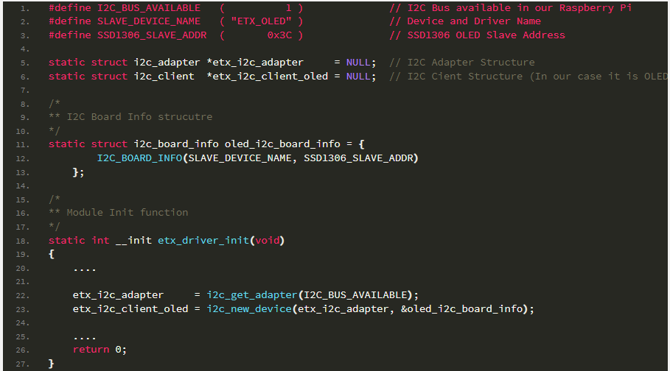

Slide 7
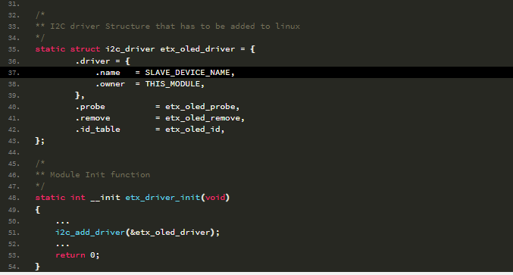
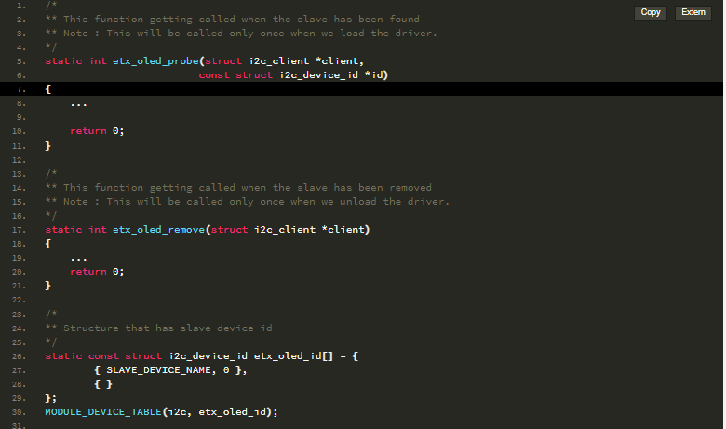

Slide 8
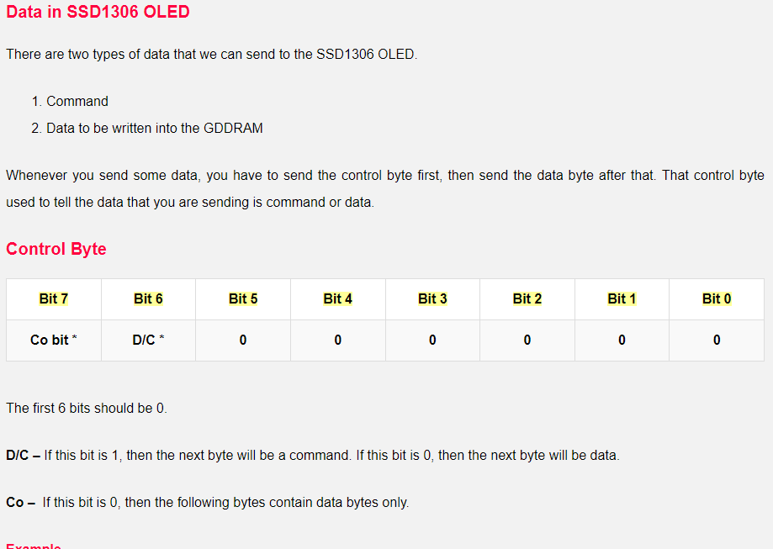
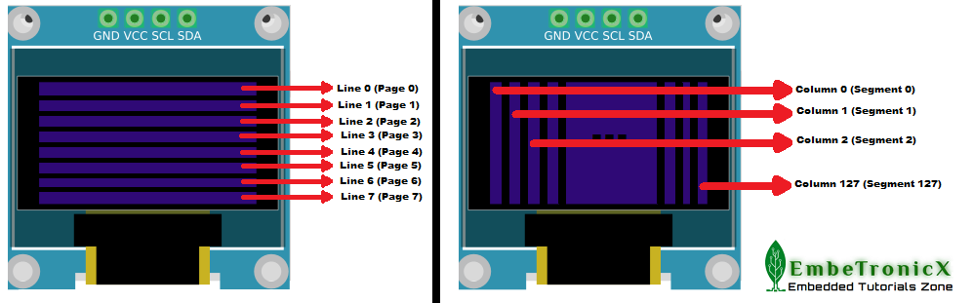

Slide 9
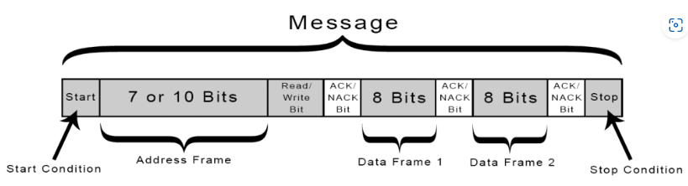

Slide 10
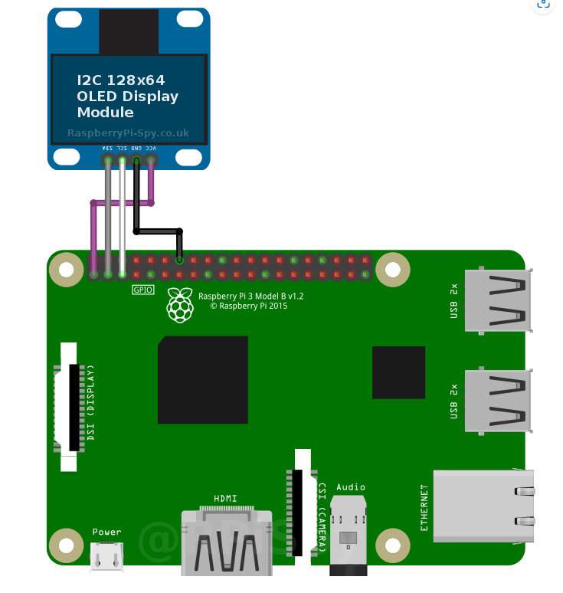
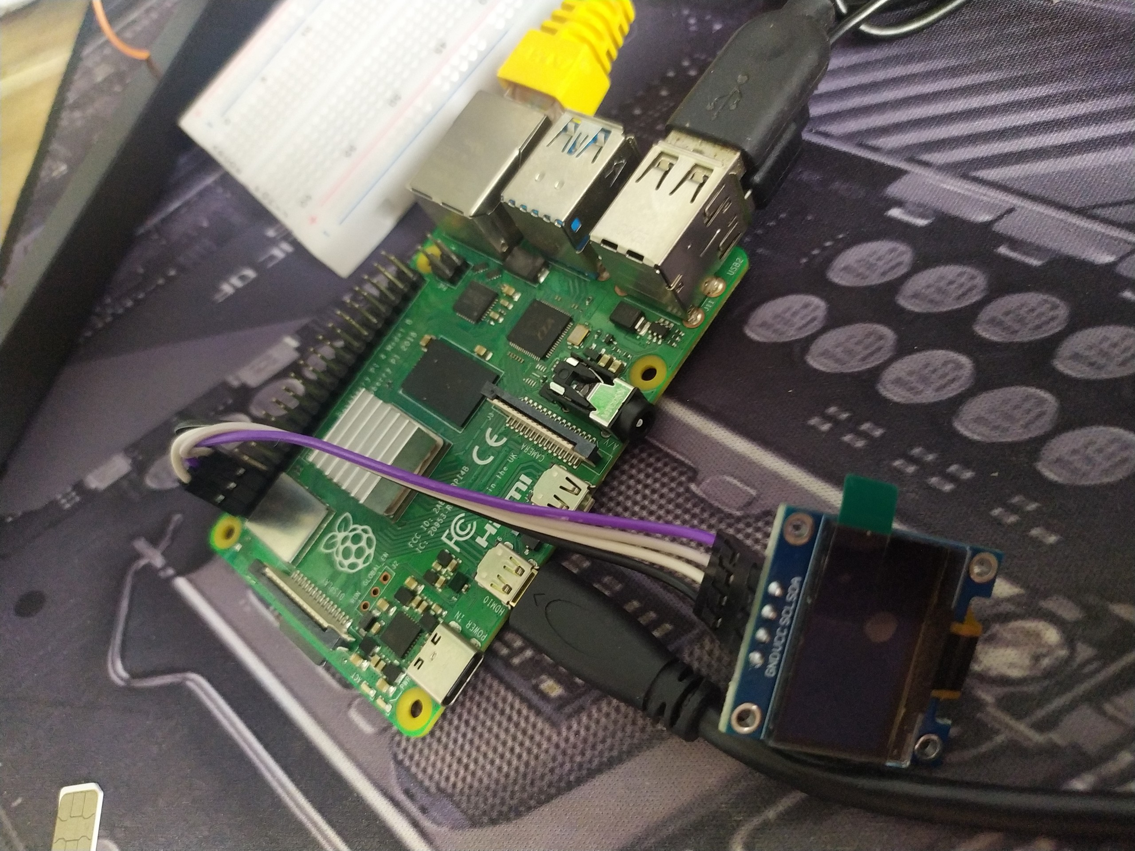

Slide 11
